Slide 1
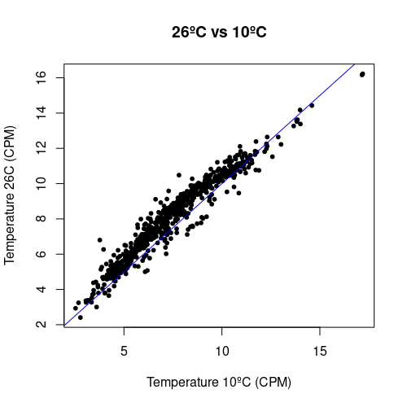
142 peaks (20.7%) significantly gain H3K27me3 as temperature rises from 10ºC to 26ºC according to a fold-change of 2 and a q-value of 0.05

Slide 2
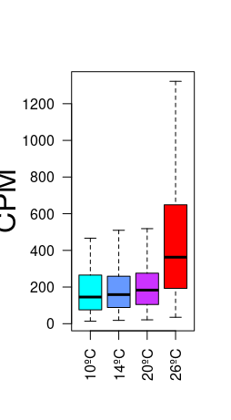
H3K27me3 levels in peaks
responding to temperature
CPM

Slide 3
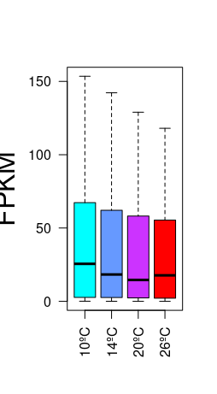
H3K27me3 levels in peaks
responding to temperature
Expression levels in genes marked by H3K27me3 peaks responding to temperature
CPM
FPKM

Slide 4
Ribosome biogenesis, protein translation
ostta01g04120 a homolog of the yeast MDN gene, which encodes a non-ribosomal protein involved in the maturation and assembly of the 60S ribosomal subunit

Slide 5
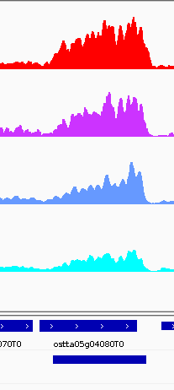
Ribosome biogenesis, protein translation
ostta05g04180 RNA helicase family

Slide 6
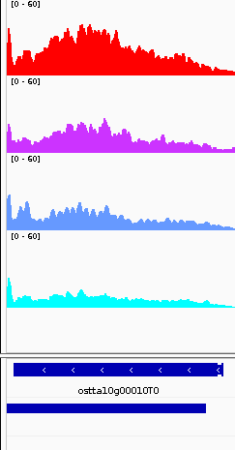
Ribosome biogenesis, protein translation
ostta10g00010 Encodes a nucleolar protein that is a ribosome biogenesis co-factor.

Slide 7
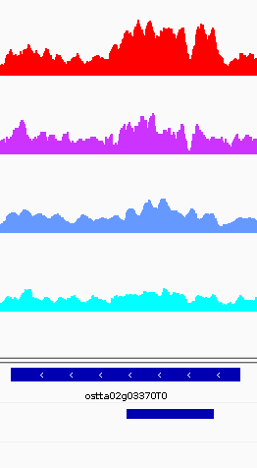
Ribosome biogenesis, protein translation
AT3G08730 - Encodes a protein-serine kinase that phosphorylates ribosomal protein in vitro. Involved in translational up-regulation of ribosomal proteins.

Slide 8
Cell cycle, Cellular organization
ostta02g01020 – AT5G42020 HSP70 Luminal binding protein (BiP2) involved in polar nuclei fusion during proliferation of endosperm nuclei. https://www.ncbi.nlm.nih.gov/pmc/articles/PMC2824368/

Slide 9
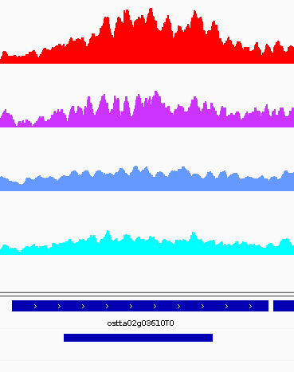
Cell cycle, Cellular organization
AT3G57060 - Similar to mamalian condensin. Mutants have reduced fertility.

Slide 10
Cell cycle, Cellular organization
AT4G33270 - Encodes a CDC20 protein that interacts with APC subunits

Slide 11
Cell cycle, Cellular organization
AT5G57390 AINTEGUMENTA-LIKE 5 EMBRYOMAKER Encodes a member of the AP2 family of transcriptional regulators. May be involved in germination and seedling growth. Essential for the developmental transition between the embryonic and vegetative phases in plants. Overexpression results in the formation of somatic embryos on cotyledons.

Slide 12
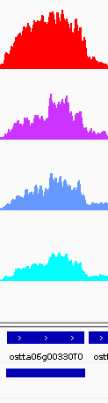
Cell cycle, Cellular organization
AT3G18524 Encodes a DNA mismatch repair homolog of human MutS gene, MSH6. MSH2 is involved in maintaining genome stability and repressing recombination of mismatched heteroduplexes

Slide 13
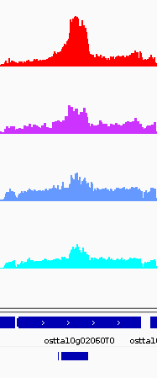
Cell cycle, Cellular organization
ostta10g02060 AT5G49150 Encodes a transmembrane domain containing protein expressed in sperm cells. Mutants are defective in gamete fusion.

Slide 14
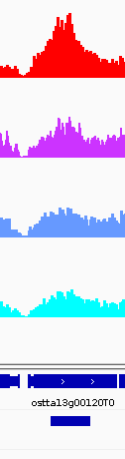
Cell cycle, Cellular organization
AT3G23890 - Encodes a topoisomerase II that is highly expressed in young seedlings. The protein is localized in the nucleus and gene expression levels are increased in proliferative tissues.

Slide 15
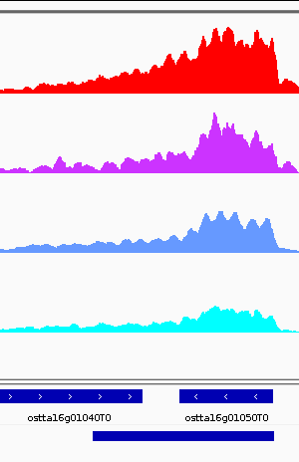
Cell cycle, Cellular organization
AT5G40440 - Encodes a mitogen-activated protein kinase kinase. Activates MPK8 and is a target of MPKKK20. Mutant root growth is sensitive oryzalin and suggestive of a role in signaling during microtubule organization.

Slide 16
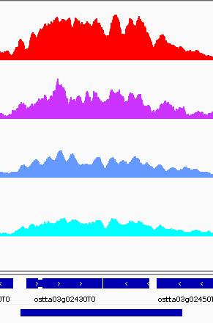
AT5G19680 PP1 Regulatory Subunit3.

Slide 17
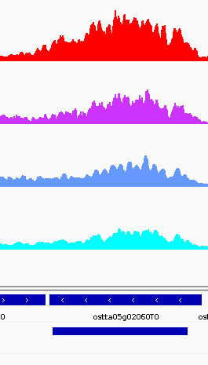
AT2G43770 - Transducin/WD40 repeat-like superfamily protein

Slide 18
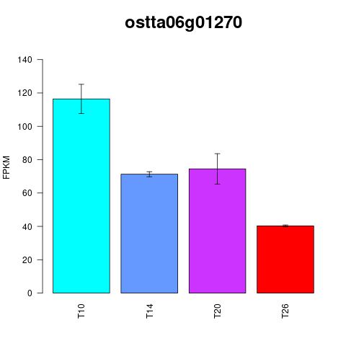
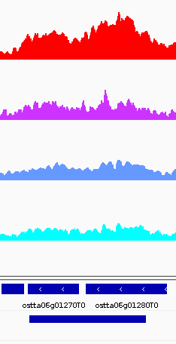

Slide 19
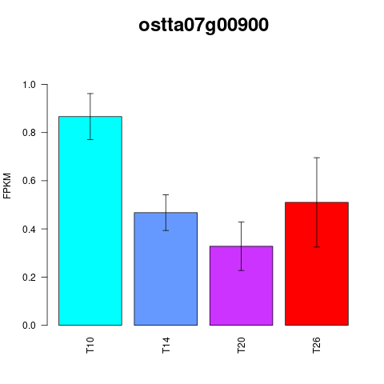
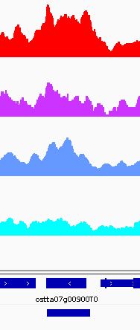

Slide 20
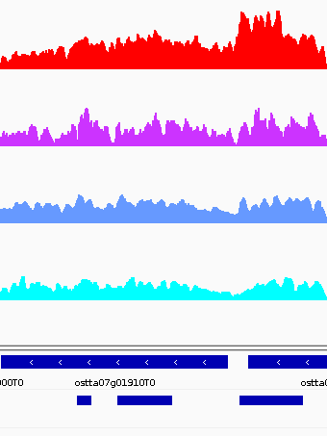
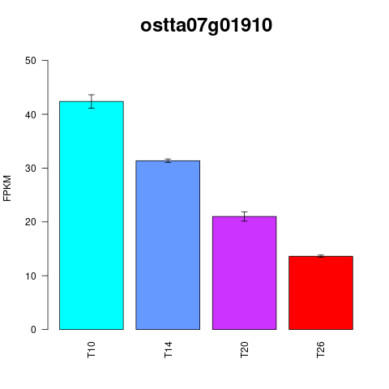
AT3G06270 Protein phosphatase 2C family protein

Slide 21
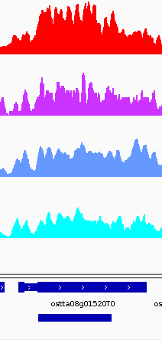
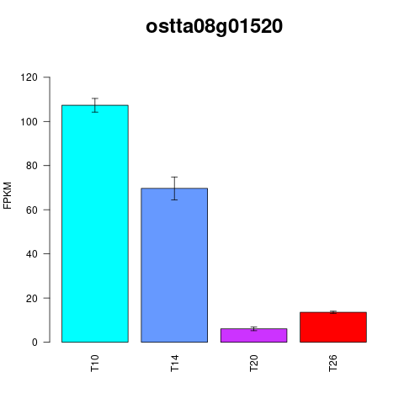

Slide 22
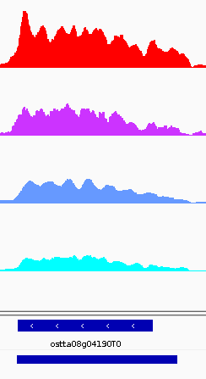
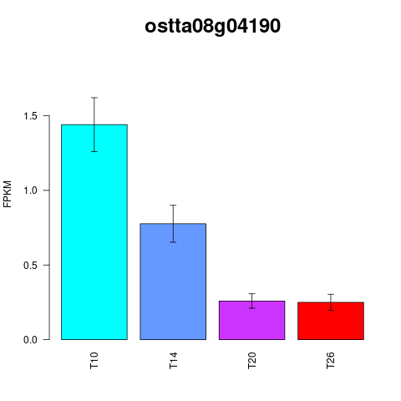
AT3G49660 WD40 repeat Encodes a structural core component of a COMPASS-like H3K4 histone methylation complex.

Slide 23
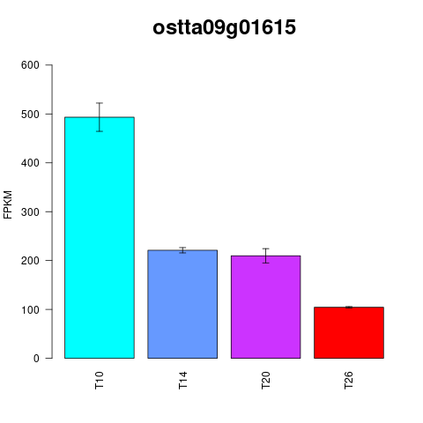
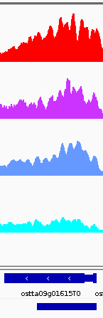
AT3G55100 ABC-2 type transporter family protein

Slide 24
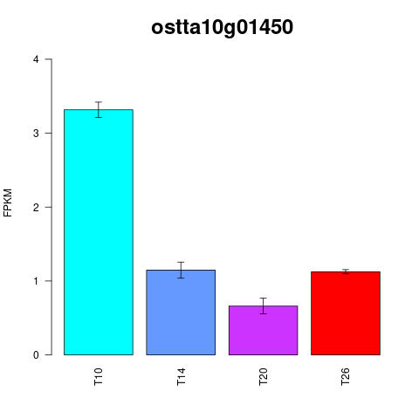
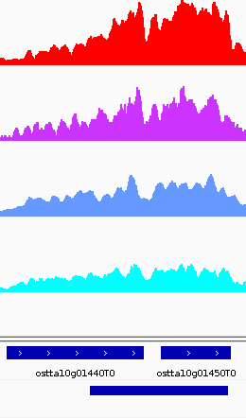
AT2G20030 ARABIDOPSIS TOXICOS EN LEVADURA 12, ATL12

Slide 25
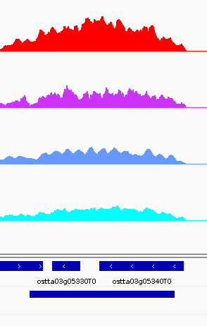
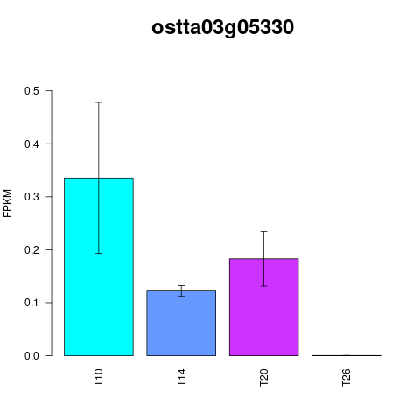
AT2G21860 - Violaxanthin de-epoxidase located in chloroplast.

Slide 26
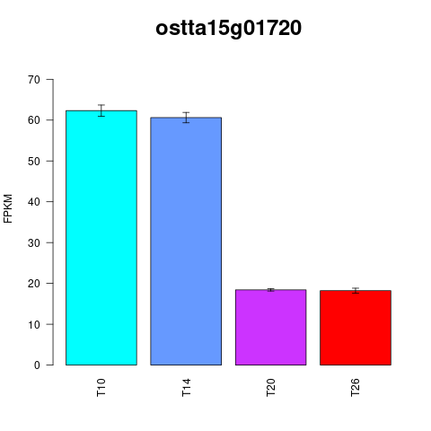
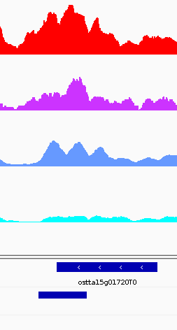
AT1G21840 - Encodes a urease accessory protein which is essential for the activation of plant urease.

Slide 27
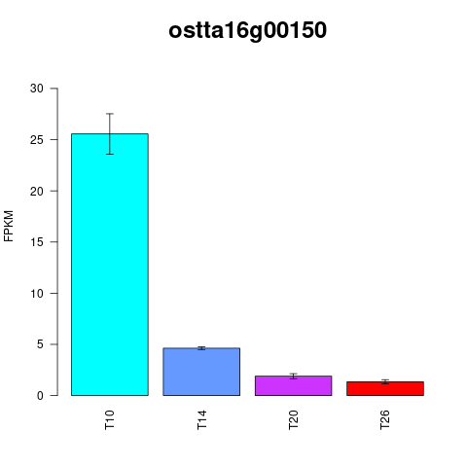
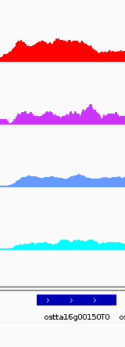

Slide 28
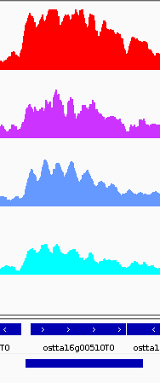
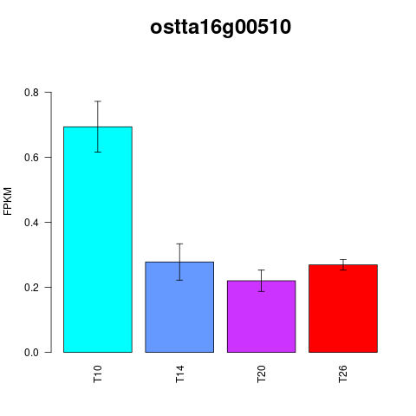

Slide 29
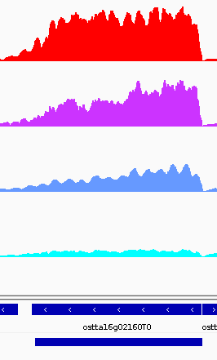
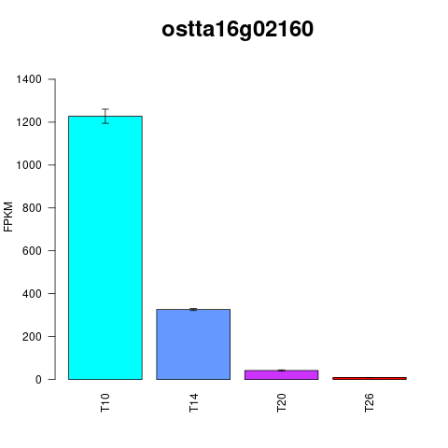

Slide 30
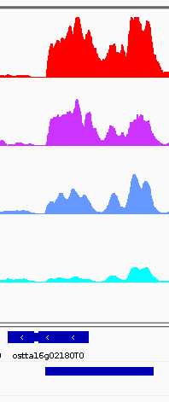
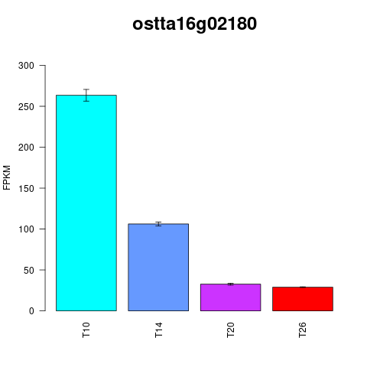
AT4G21090 MITOCHONDRIAL FERREDOXIN 2

Slide 31
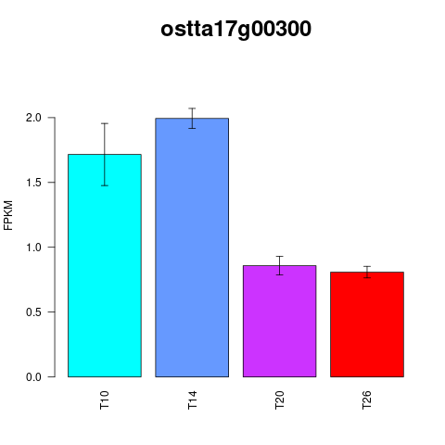
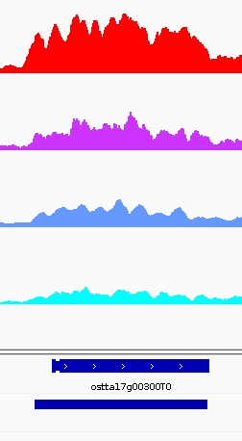
AT3G45770 Encodes a mitochondrial enoyl-ACP reductase, a component of the fatty acid synthase complex.

Slide 32
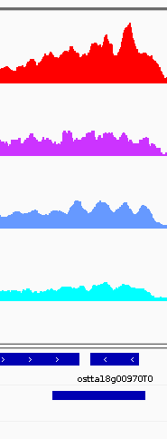
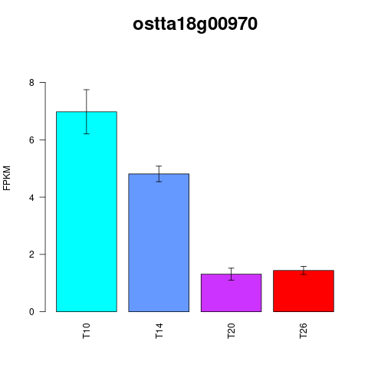

Slide 33
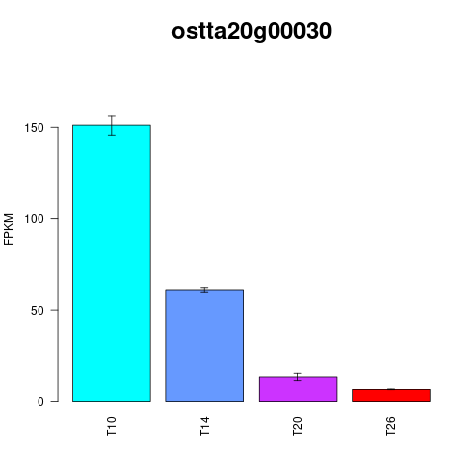
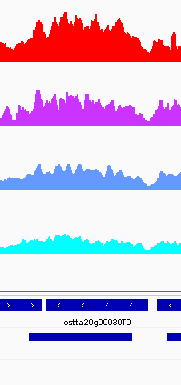
AT2G30200 - Malonyl-ACP expressed in developing seeds

Slide 34
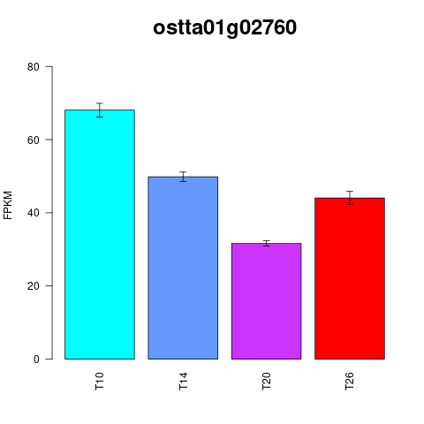
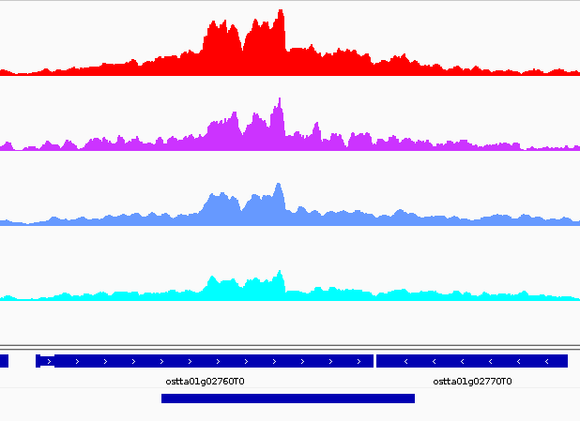
ostta01g02760 Carbohydrate binding module family 20

Slide 35
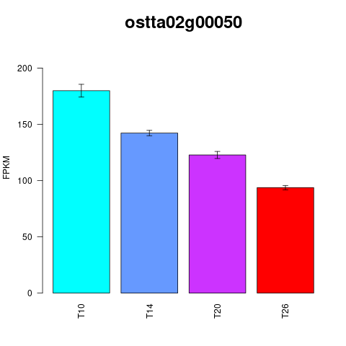
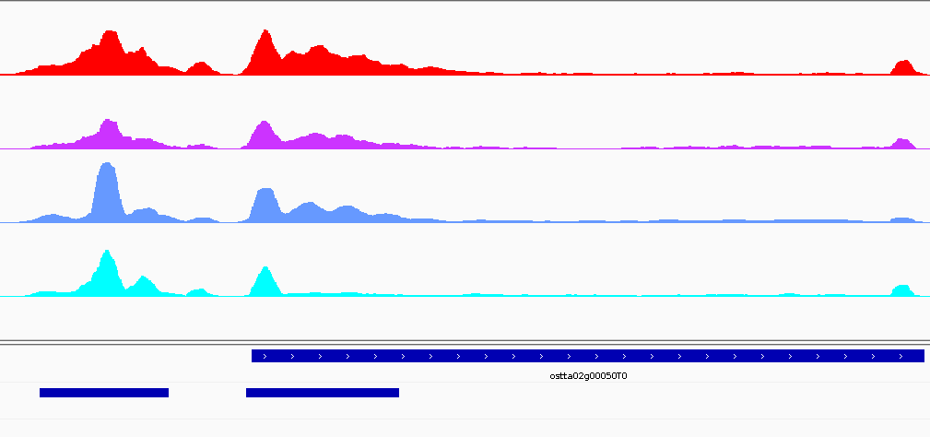
ostta02g00050 Ribonuclease H-like domain

Slide 36
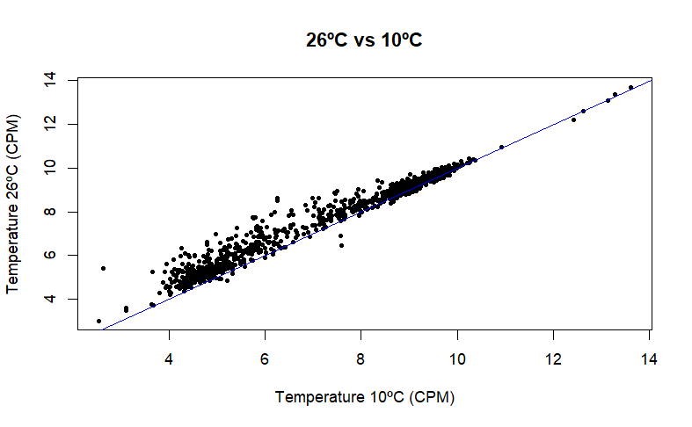
H3K4me3
83 peaks (7.85%) significantly gain H3K4me3 as temperature rises from 10ºC to 26ºC according to a fold-change of 2 and a q-value of 0.05

Slide 37

H3K4me3

Slide 38

H3K4me3

Slide 39


Protein Quality Control
ostta09g01040: Tetratricopeptide repeat
AT1G62740.1 Encodes one of the 36 carboxylate clamp (CC)-tetratricopeptide repeat (TPR) proteins (Prasad 2010, Pubmed ID: 20856808) with potential to interact with Hsp90/Hsp70 as co-chaperones. The mRNA is cell-to-cell mobile.

Slide 40


Protein Quality Control
ostta13g00885 hypothetical protein
AT4G04330.1Encodes a chloroplast thylakoid localized RbcX protein that acts as a chaperone in the folding of Rubisco.

Slide 41


Protein Quality Control
ostta02g00380 Clp protease proteolytic subunit /Translocation-enhancing protein TepA
AT4G17040.1HON5 (At4g17040) encodes the ClpR4 subunit of the chloroplast-localized Clp protease complex. hon mutations disturb plastid protein homeostasis, thereby activating plastid signaling and inducing stress acclimatization. GO Biological Process acts upstream of or within regulation of gene expression, response to reactive oxygen species. GO Biological Process involved in protein quality control for misfolded or incompletely synthesized proteins

Slide 42


Protein Quality Control
οstta02g01460 Proteasome A-type subunit
AT1G47250.120S PROTEASOME ALPHA SUBUNIT F2, PAF2

Slide 43


Protein Quality Control
ostta10g00190 Zinc finger, RING-CH-type
AT3G47550 GO Biological Process autophagy, cellular response to hormone stimulus, cellular response to oxygen-containing compound, defense response to bacterium, defense response to fungus, leaf senescence, protein modification process, response to lipid, response to temperature stimulus, response to water, signal transduction, transport. Involved in Protein ubiquitination

Slide 44


ostta03g01360 unnamed product
AT3G10800.1 Encodes bZIP28, a putative membrane-tethered transcriptional factor. Up-regulated in response to heat; a bZIP28 null mutant has a heat-sensitive phenotype.

Slide 45


ostta08g02280 Succinate dehydrogenase [ubiquinone] cytochrome b small subunit, CybS
AT3G03540.1 Encodes a nonspecific phospholipase C. Located in the cytosol. Involved in the conversion of phospholipids to glycolipids under phosphate deprivation conditions. DNA chip-based expression profile analysis indicates involvement of the phosphatidylinositol signaling pathway in multiple plant responses to hormone and abiotic treatments.

Slide 46


ostta02g02240 Pyridoxal phosphate-dependent transferase, major region, subdomain 1
AT1G27980.1 Encodes an ER-localized sphingoid long-chain base-1-phosphate lyase involved in the dehydration stress response.

Slide 47


ostta02g04570 Glycoside hydrolase, catalytic domain
AT4G17090.1Encodes a beta-amylase targeted to the chloroplast. Transgenic BMY8 RNAi lines fail to accumulate maltose during cold shock suggesting that maltose accumulation coincides with BMY8 expression.

Slide 48


ostta12g01860
AT4G37930.1 Encodes a protein with mitochondrial serine hydroxymethyltransferase activity, which functions in the photorespiratory pathway, catalyzes the conversion of serine and tetrahydrofolate to glycine and 5,10-methylene tetrahydrofolate. Involved in controlling cell damage caused by abiotic stress, such as high light and salt and the hypersensitive defense response of plants.

Slide 49


ostta02g02710 UbiA prenyltransferase family
AT2G18950 Encodes homogentisate phytyltransferase involved in tocopherol biosynthesis. Has impact on seed longevity and plays a role in the adaptation to low temperature stress, notably phloem loading.

Slide 50


ostta02g00220 unnamed product

Slide 51


ostta16g01060 Histone core
AT3G20670.1 Encodes HTA13, a histone H2A protein.

Slide 52
>ostta14g01070 length:96 (mRNA) () (Ribosomal protein L33) (n/a) (Ribosomal protein L33)
ostta14g02197 length:237 (mRNA) () (6,7-dimethyl-8-ribityllumazine synthase) (n/a) (6,7-dimethyl-8-ribityllumazine synthase) Ribosomal protein S8e/ribosomal biogenesis NSA2
ostta02g01247 length:524 (mRNA) (n/a) (Transposase, Tc1-like)
ostta02g02530 length:67 (mRNA) (n/a) (U1 small nuclear ribonucleoprotein C)
ostta06g02290 length:432 (mRNA) (n/a) (Cobalamin (vitamin B12) biosynthesis CobW-like, C-terminal)
ostta08g01330 length:306 (mRNA) (n/a) (High mobility group box domain)
ostta09g00950 length:66 (mRNA) (n/a) (unnamed product)

